Slide 1

Note-making
Disability Support Service

Slide 2
Retaining Information
Studies have shown that people forget
50% of a lecture within 24 hours
80% of a lecture in 2 weeks
95% of a lecture within one month
…if they DO NOT make notes.

Slide 3
Work to improve note-making
Here’s a task:
Go back to class notes that you took earlier this week. Do they make sense? Do you feel as though you are in the lecture and hearing the lecturer talk about the topic?
Go back to class notes that you took earlier this month. Do they make sense? Do you feel as though you are in the lecture and hearing the lecturer talk about the topic?

Slide 4
How to improve note-making
Before class
Read assigned material
Review notes from previous lecture
Sit near the front of the class in the centre of the room
Start each lecture on a new page, write the date on it as well as on any hand-outs given
Identify the textbook chapter by name at the top of the leading page, if relevant

Slide 5
How to improve note-making
During class
Carefully listen at the start of the lecture for an overview of the main topics of the lecture
Maintain focus to identify the most important information
Write key points, background information, dates, key terms, definitions, examples, formulas. Don’t attempt to capture every word.
Listen carefully at the end of the lecture for a summary of the main points.

Slide 6
How to improve note-making
After class
Review, revise or edit notes as soon as possible
Rewrite notes, if necessary
In your notes, highlight and summarize the main points of the lecture

Slide 7
Methods
Cornell Note-making Method Listen, think, & create lecture notes. Organize your notebook like this:
Question Column | Cue Column –response to the question
How to prepare for note-making | •Preparation – read the assignment
How to take notes during class | •Pay attention and watch for cues
 | •Participate in class discussion.
 | •Ask questions.
After class | •Review notes as soon as possible after class
 | •Rewrite notes to help remember
Summary of the main points | Read the assignment before class to enable participation in the class discussion and to get any questions answered. Pay attention so as not miss important information. Review notes for clarity and understanding as soon as possible after a lecture.

Slide 8
Methods
Outline Method
Organizational technique to show main points, sub-points and details. Enables presentation of information in a more organized way.
Effective note-making techniques help to:
  Create an outline of a class lecture or textbook reading
  Summarize and retain important information
  Practice critical thinking skills to connect with information

Slide 9
Methods
Mind Mapping Method
Ability to see the “big picture” and how information relates
Useful method to review notes
Allows creativity

Slide 10
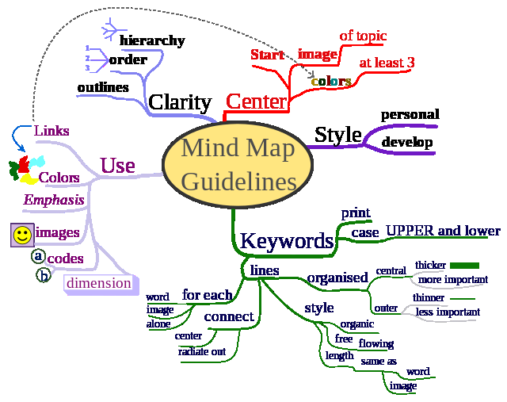
Mind mapping example
http://en.wikipedia.org/wiki/Mind_map#mediaviewer/File:MindMapGuidlines.svg

Slide 11
Skills4Study module
Reading and note-making
Reading and note-making provides strategies to help students select relevant information through lectures, reading, discussion and their own research, as well as approaches for making effective notes that will prove useful later on.
Sign up via Blackboard: Learning Centre

Slide 12
Conclusion
Don’t try to write everything that the lecturer says
  Be prepared for class
  Use critical thinking skills
Review your notes and practice
  Schedule time to review notes in your daily schedule.
  Talk about what you are learning with others

Slide 13
References
http://www.eiu.edu/~lrnasst/notes.htm
http://www.westshore.edu/webs/ltc/cornell_note_taking_method.htm
http://printables.familyeducation.com8%2C33953%2C28212%2C28213%2C28214%2C9211%2C28719
Cornell Method information adapted from How to Study in College 7/e
https://www.svcc.edu/students/success/workshops-pdf/note-taking.pdf

