Slide 1
Time Management
Disability Support Service

Slide 2
What is Time Management?
Organising your time and putting day to day tasks into a clear timetable.
Creating a routine which will create good habits and put you in control.

Slide 3
Why is it a good idea?
Take a moment to list some of the reasons why time management is a good idea.

Slide 4
Why is it a good idea?
Students, particularly first years who are coming from a school/home background have no experience of time managing themselves.
Non traditional students may have many other factors in their lives they need to account for along with coping with the demands of a college course.
Planning out a schedule and getting into a routine shows that the demands of college and life are manageable.
This helps to reduce stress, improves performance and allows for time to do other things outside of college

Slide 5
What do you need ?
Make a quick list of what you think you need to do time management.

Slide 6
What you need
A good diary
A clear timetable
A set study space that is equipped and organised. What should this have?
A year at a glance planner.
What other items could be used?

Slide 7
Timetable
TIME | MONDAY | TUESDAY | WEDNESDAY | THURSDAY | FRIDAY | SATURDAY | SUNDAY
8:00 – 9:00
9:00 – 10:00
10:00 – 11:00
11:00 – 12:00
12:00 - 1:00
1:00 – 2:00
2:00 – 3:00
3:00 – 4:00
4:00 – 5:00
5:00 – 6:00
6:00 – 7:00
7:00 – 8:00
8:00 – 9:00

Slide 8
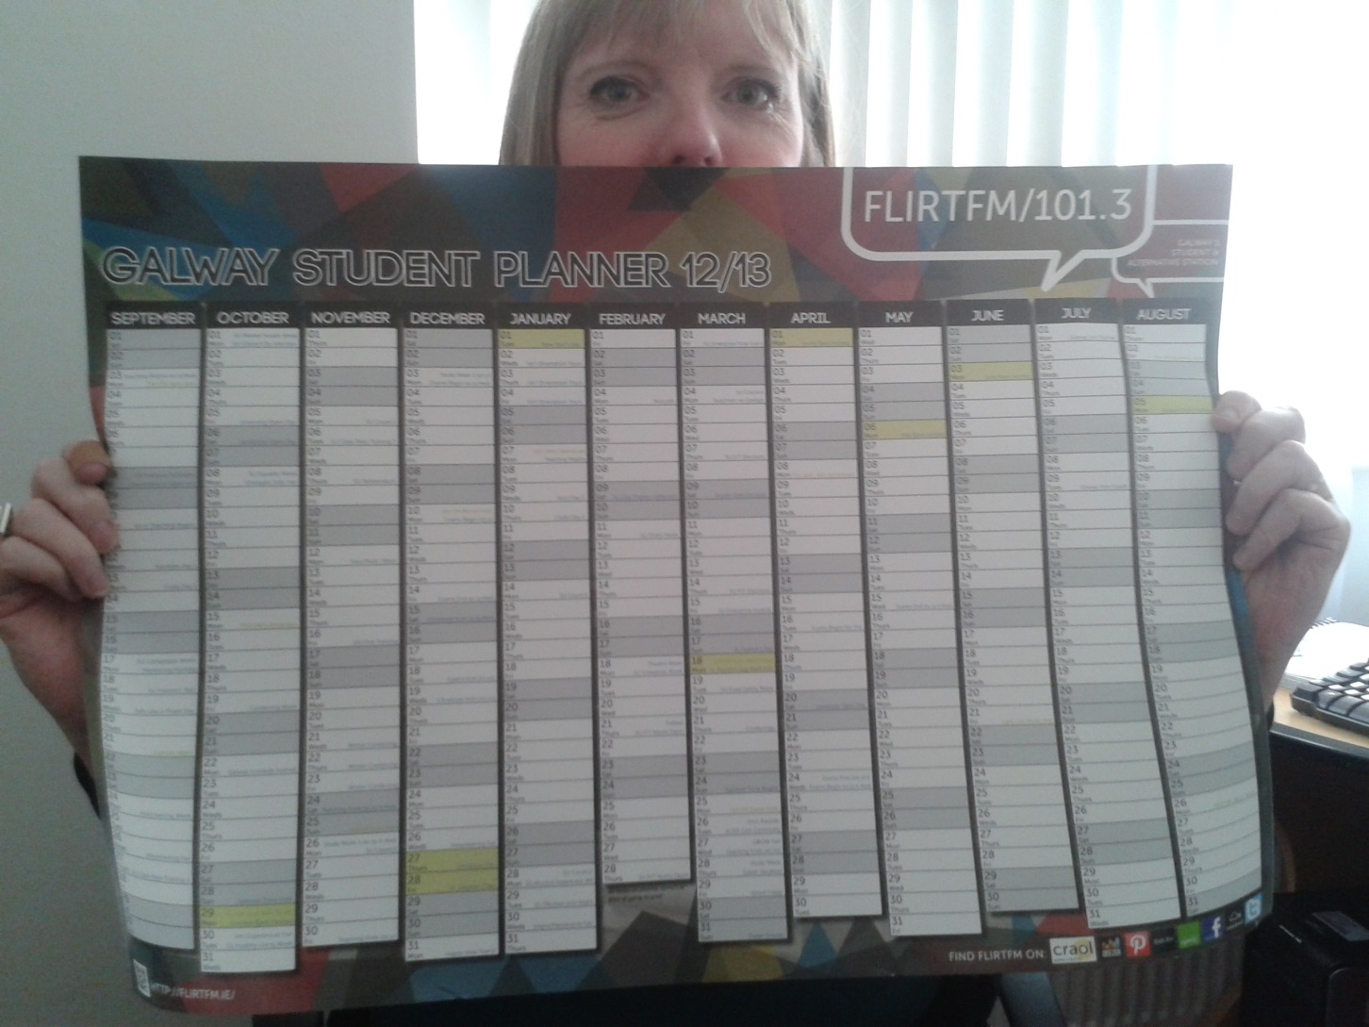
Year Planner

Slide 9
Helping to create good Time Management
Every student is different and has different requirements.
The Time Managed routine needs to be practical and realistic. It must be something that the student feels they can realistically stick to.
The student needs to be fully aware that this is THEIR routine – they are only answerable to themselves.

Slide 10
Getting Started
Pick a start time. This needs to be realistic and some people are morning people and some are not.
When is the first lecture? This can help to decide when is a good time to start everyday. If there are only two 10o’clock starts – how do they feel about starting at that time every day?
If they decided to start every day at 10 then they need to decide what they plan to do when they get in at that time.

Slide 11
Definite time commitments
The student needs to put in all the hours they are committed for:
Lectures.
Tutorials/labs
Group work
Anything else that is a definite time commitment every week.

Slide 12
Example: First Arts
8:00 – 9:00
9:00 – 10:00
10:00 – 11:00 | ARCHAEOLOGY | ARCHAEOLOGY | ARCHAEOLOGY
11:00 – 12:00 |  | SOC/POL |  | SOC/POL | CLASSICS (T)
12:00 - 1:00 | SOC/POL. (T)
1:00 – 2:00 |  | ENGLISH. | SOC/POL | ARCHAEOLOGY(T) | ENGLISH
2:00 – 3:00 |  |  | CLASSICS
3:00 – 4:00 | CLASSICS.
4:00 – 5:00 |  |  | ENGLISH (T)
5:00 – 6:00 |  | CLASSICS |  | ENGLISH
6:00 – 7:00
7:00 – 8:00
8:00 – 9:00

Slide 13
Other commitments
When will the student take breaks or do other things they maybe committed for?
Breaks
Lunch
Evening meal
Clubs/societies/sports
Nights out
Travel
Work

Slide 14
Example: First Arts
TIME | MONDAY | TUESDAY | WEDNESDAY | THURSDAY | FRIDAY | SATURDAY | SUNDAY
8:00 – 9:00
9:00 – 10:00
10:00 – 11:00 | ARCHAEOLOGY | ARCHAEOLOGY | ARCHAEOLOGY
11:00 – 12:00 | BREAK | SOC/POL |  | SOC/POL | CLASSICS (T)
12:00 - 1:00 | SOC/POL. (T) |  | BREAK
1:00 – 2:00 |  | ENGLISH. | SOC/POL | ARCHAEOLOGY(T) | ENGLISH
2:00 – 3:00 |  | BREAK | CLASSICS | BREAK
3:00 – 4:00 | CLASSICS. |  |  |  | HOME
4:00 – 5:00 |  |  | ENGLISH (T)
5:00 – 6:00 |  | CLASSICS |  | ENGLISH
6:00 – 7:00 | BREAK | BREAK | BREAK | BREAK
7:00 – 8:00 | Drama Society. |  | Judo.
8:00 – 9:00 | Drama Society

Slide 15
Looking at the time left.
The time that is left is time that could be used for dealing with the other demands of the course.
Reviewing lecture notes: How long is needed?
Preparing for assignments: It’s a good idea to have a couple of good blocks of time set aside for this. This will develop the habit of acting on assignments immediately.
General study/reading (using exam papers)

Slide 16
Example: First Arts
TIME | MONDAY | TUESDAY | WEDNESDAY | THURSDAY | FRIDAY | SATURDAY | SUNDAY
8:00 – 9:00
9:00 – 10:00
10:00 – 11:00 | ARCHAEOLOGY | ARCHAEOLOGY | ARCHAEOLOGY
11:00 – 12:00 | BREAK | SOC/POL |  | SOC/POL | CLASSICS (T) | Study/Reading.
12:00 - 1:00 | SOC/POL. (T) |  | BREAK |  | BREAK. | Study Reading.
1:00 – 2:00 | Study/Reading. | ENGLISH. | SOC/POL | ARCHAEOLOGY (T) | ENGLISH
2:00 – 3:00 | Study/ Reading. | BREAK | CLASSICS | BREAK | Lecture Review. File.
3:00 – 4:00 | CLASSICS. | Assignment Prep. |  | Assignment Prep. | HOME.
4:00 – 5:00 | Lecture review. File. | Assignment Prep. | ENGLISH (T) | Assignment Prep.
5:00 – 6:00 |  | CLASSICS | Lecture review. File. | ENGLISH
6:00 – 7:00 | BREAK | BREAK | BREAK | BREAK
7:00 – 8:00 | Drama Society. | Lecture review. File. | Judo. | Lecture review. File.
8:00 – 9:00 | Drama Society |  | Night Out.

Slide 17
Try to allow for time off.
One day a week. Perhaps Saturday or Sunday
One half day: Probably Friday.
One evening: A night out.
The example timetable we have looked it is not completely full. This is advisable as it allows some flexibility and allows more personal control. Many students who have used this technique have reported that they have in fact done more work when they feel less stressed and in control.

Slide 18
Time Management Exercise.
Work in pairs to create some good time management for these students.
Each pair will be given a card. On the card is a ‘student’ and some information about them. Work together to come up with a good time managed routine for him or her.
This will then be presented to the group who will be able to engage in a discussion around this.

Slide 19
Time Manage yourself!
Do you think you might benefit from this yourself?
How do you think it would be beneficial?

